Slide 1


IT Industry Sector partnership forum
Workforce Solutions + Pharr EDC

Slide 2
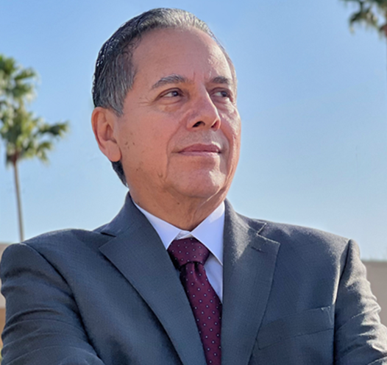
Frank almaraz
Francisco Almaraz was appointed CEO of WFS in August 2014. As CEO, Mr. Almaraz has planning oversight and fiduciary responsibility of the organization that oversees workforce development services for Hidalgo, Starr, and Willacy Counties in South Texas. With over 25 years of experience in financial accounting, auditing, and investigations, Mr. Almaraz brings his expertise to ensure that internal control systems are operating efficiently and effectively in the development of the local workforce training, job seeker and business services.

Slide 3
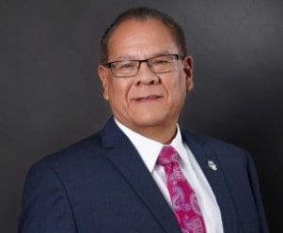
Victor Perez
A lifelong native of the Pharr-San Juan-Alamo (PSJA) area, Victor Perez is President and Chief Executive Officer for the Pharr Economic Development Corporation. As President & CEO, he works to promote and maintain the economic vitality and quality of life in the city of Pharr by stimulating capital investment, retention and attraction of industry and job creation. Perez boasts a strong background in management experience, previously servings as Principal, and District Administrator for School Operations at Progreso Independent School District after having served in various leadership capacities at the district since 2004. Perez graduated from the University of Texas-Pan American with a Bachelor of Science degree and a Master’s Degree in Educational Administration.

Slide 4
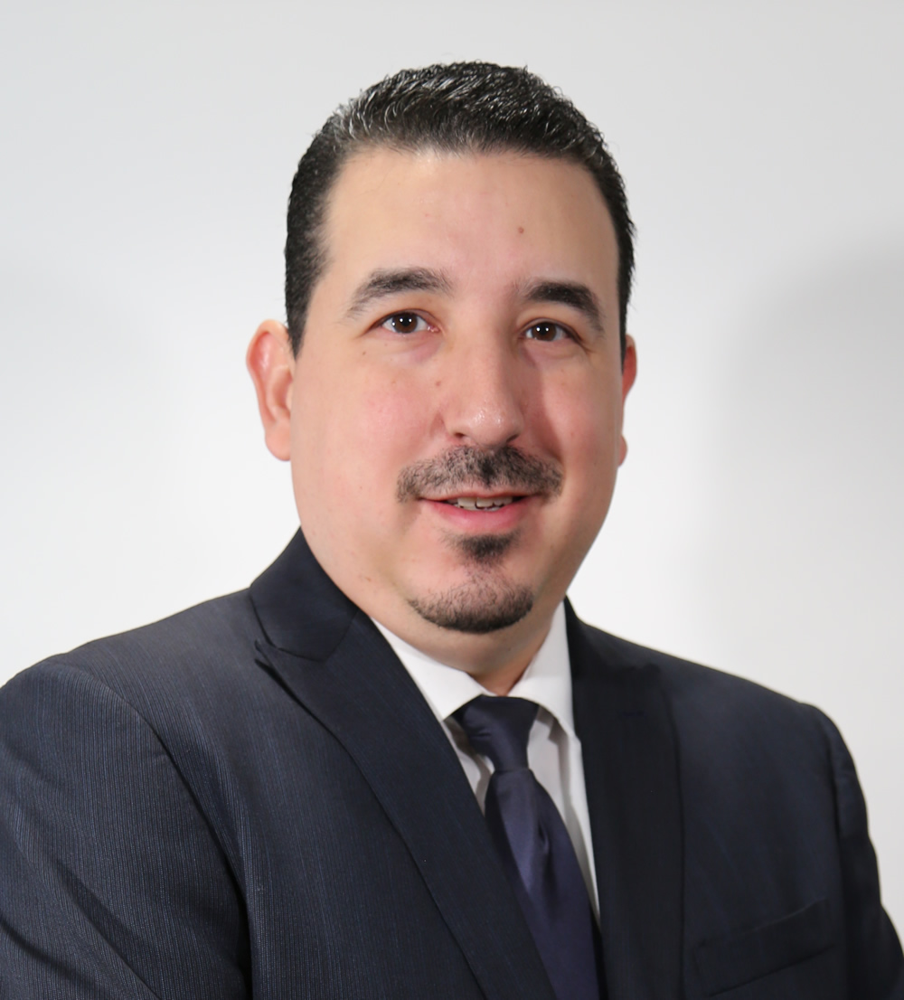
Jose J. Pena
Mr. Peña is the IT Director for the City of Pharr. With 20 years of service in public sector, Mr. Peña has a proven track record of driving efficiency in municipal operations, from behind-the-scenes application development of ground-breaking services to the month-to-month activities of department operations. Identifying ways to leverage technology and development to increase operational effectiveness across all departments.

Slide 5
5 min q&a
Any questions for the presenter?

Slide 6
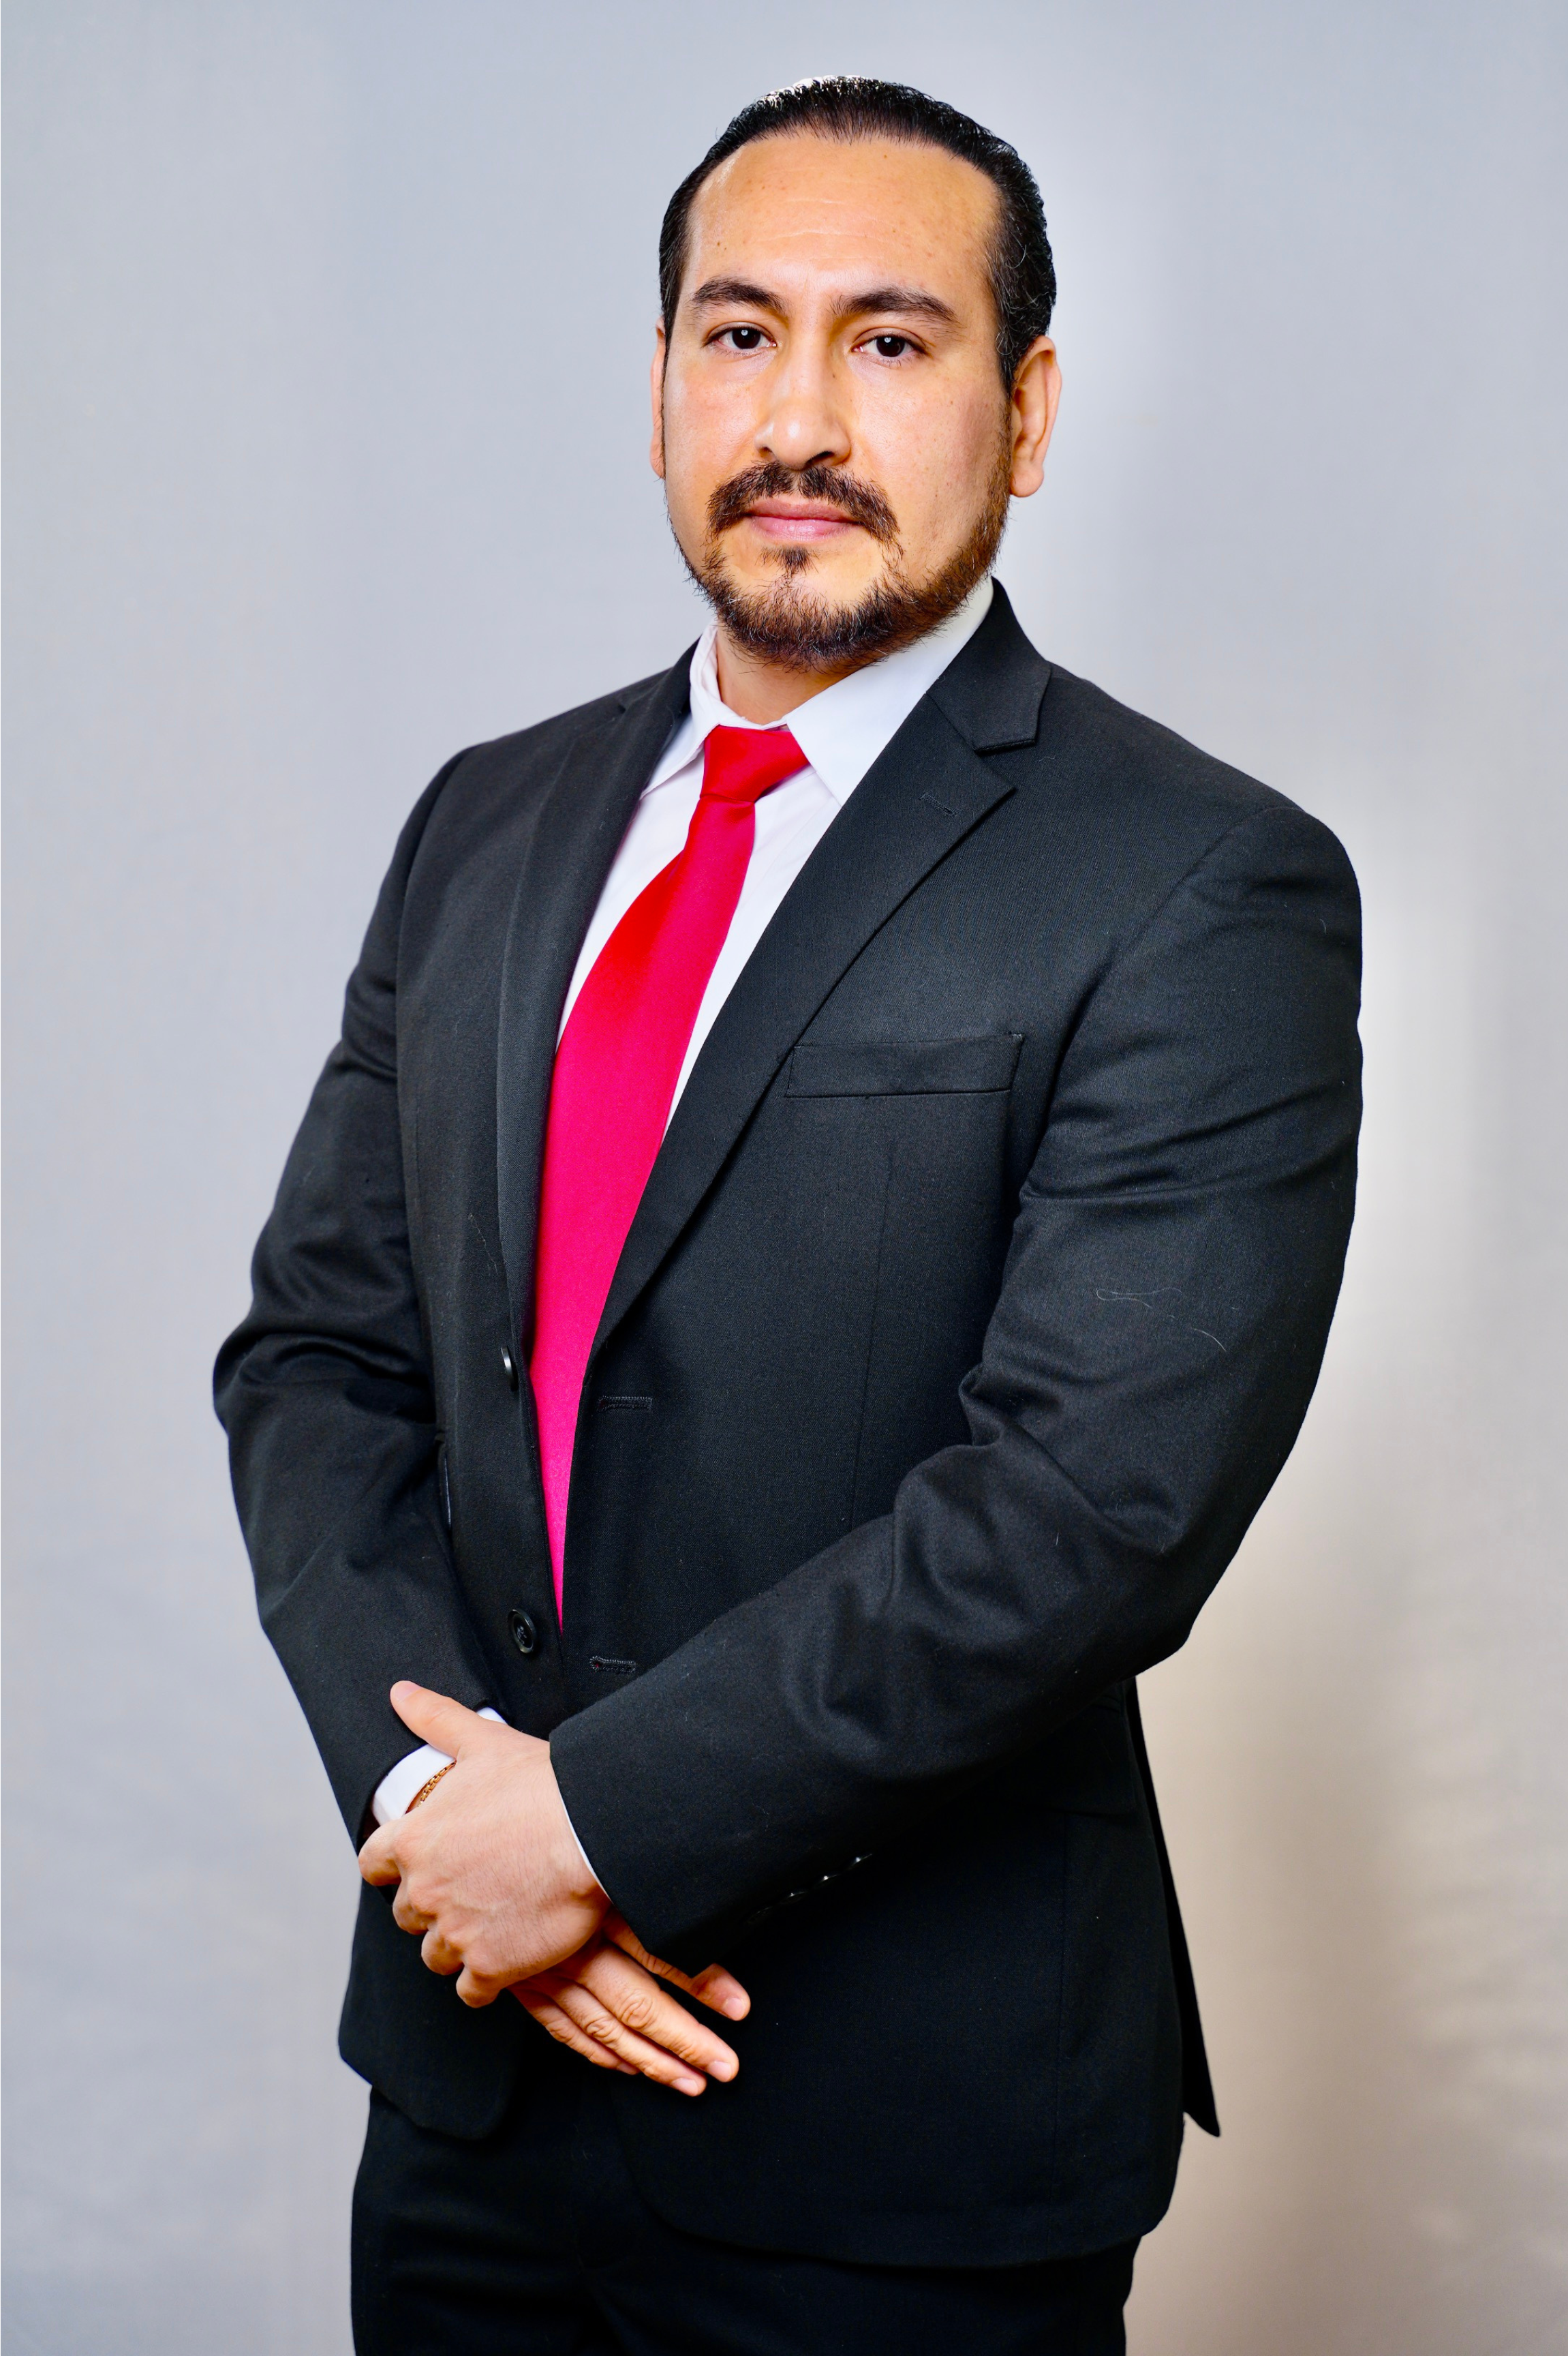
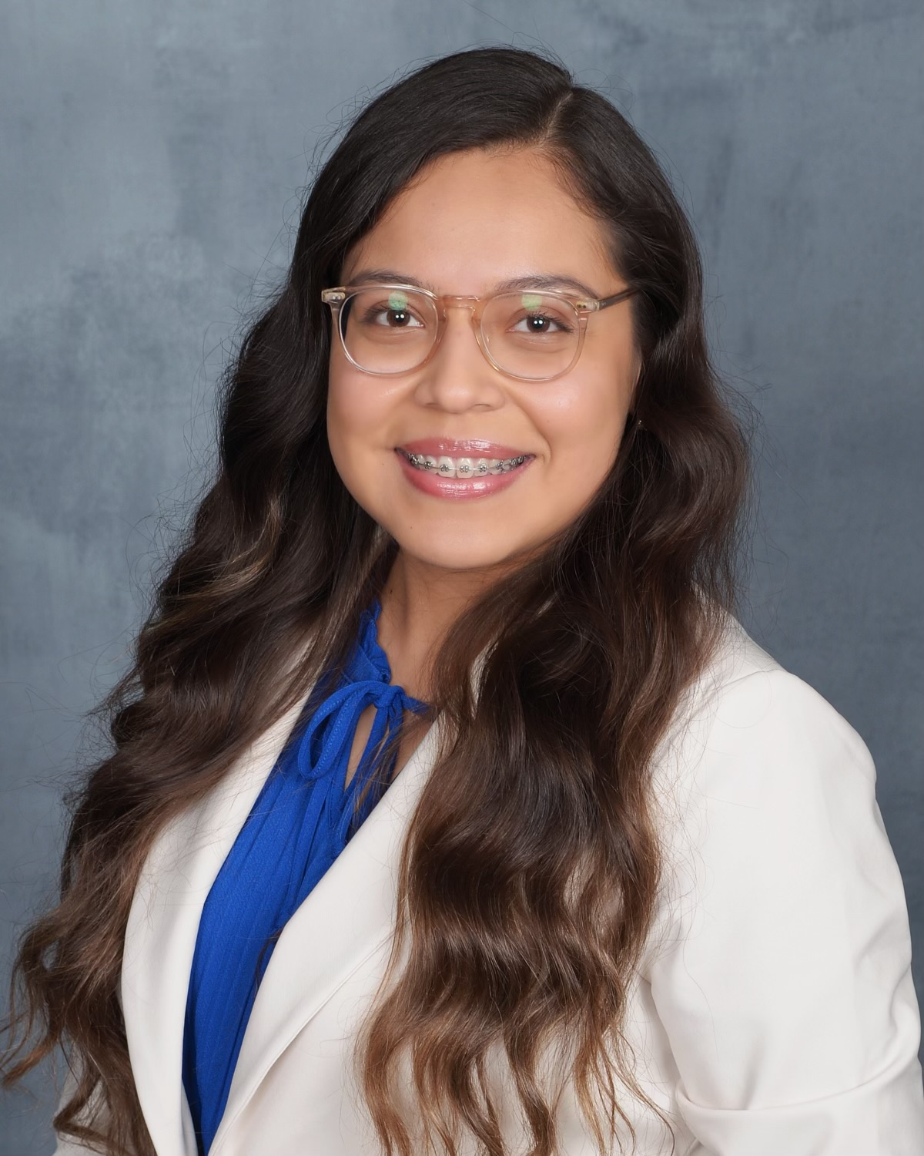
Elena Pacheco
Elena Pacheco holds a B.A. in English and Government from the University of Texas at Austin and is a Certified Tax Preparer. She currently serves as a Business Relations Representative with Workforce Solutions, the local Workforce Board which delivers services to the counties of Hidalgo, Starr, and Willacy. With Workforce Solutions, Ms. Pacheco will focus on growing the Information Technology sector in the Rio Grande Valley as well as support general economic and workforce development.
Daniel URIBE
Daniel Uribe holds a Bachelor's Degree in Computer Systems from the Tecnológico de Monterrey in Mexico, and a Master’s Degree in Computer Science in Information Technology from the University of Texas Rio Grande Valley. As part of the Workforce Solutions leadership team, Daniel Uribe, serves as the Business Relations & Information Manager. He has over 18 years of experience in workforce development.

Slide 7
5 min q&a
Any questions for the presenters?

Slide 8
5 min break
Please feel free to grab refreshments.

Slide 9

Elizabeth Ramirez
Elizabeth Ramirez is the Founder of The Lifestyle Biz, a visionary entrepreneur, business coach, and brand & system strategist. She embarked on her entrepreneurial journey after leaving the corporate world where she worked in Sales & Operations. Elizabeth Ramirez continues to inspire individuals to create thriving businesses that not only yield financial success but also enrich their overall lifestyle.

Slide 10
5 min q&a
Any questions for the presenter?

Slide 11
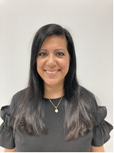
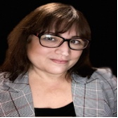
Cecilia Nava & Deidre scoggins
TWS-VRS, formally known as DARS, supports people with disabilities to prepare for, obtain, and advance in meaningful employment by providing of range of services based on an individual’s employment goals.

Slide 12
5 min q&a
Any questions for the presenters?

Slide 13
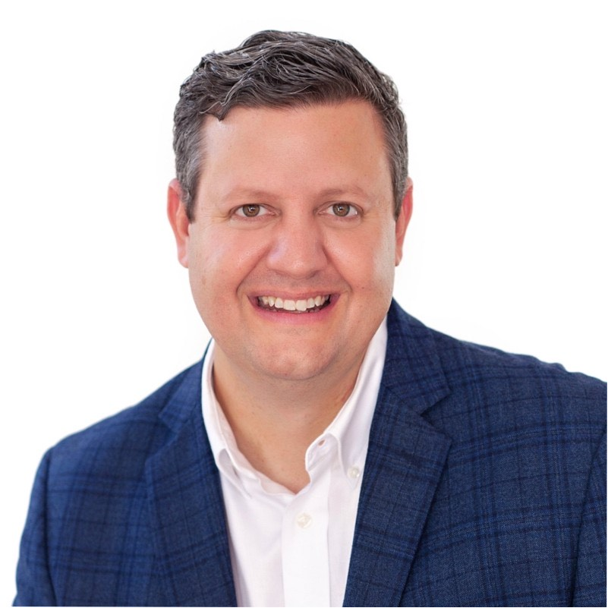
Drew Lentz
Drew Lentz has a 30-year career in data delivery networks with experience designing transformative solutions for everyone from Fortune 50 companies to rural and disconnected communities across the globe. His work in the Rio Grande Valley has been recognized for its pioneering efforts, which has led to a career with organizations like Comcast, Meta, and now as part of the wireless product management team at Cisco Systems.

Slide 14
5 min q&a
Any questions for the presenter?

Slide 15
THANK YOU!
Closing Remarks & Networking

