Slide 1

Thank you for joining!
We will begin shortly…

Slide 2
Welcome!
A couple reminders:
  You have been muted when you joined the call.
  This webinar will be recorded for future viewing.
  Please type any questions into the Q&A or chat box.
  Closed Captions are available, to activate click the CC button. Para subtitulos en Español, por favor de abrir el enlace que se encuentra en el chat: bit.ly/VirtualTransitionFair.
  If you have not received copy of slides, email us at: navigators@wfsolutions.org

Slide 3
Welcome!
A couple reminders:
  Today’s Transition Fair will run for approximately 2 hrs.
  Presenters will speak to transitioning into the Workforce, Post-Secondary Education, and Community.
  Each presentation is scheduled to last 15 minutes.
  Questions will be answered in the chat box throughout Transition Fair.

Slide 4

Mere Y. Vela, Community Liaison

Slide 5
Workforce Solutions Services

Slide 6
Welcome!
Thank you for inviting to participate in todays Virtual Transition Fair.
Its always a pleasure being able to share our information and give everyone an overview of the services Workforce Solutions (WFS) has to offer and our upcoming job fairs.

Slide 7
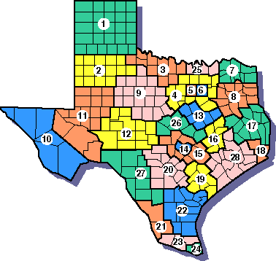
About WFS
Hours of Operation: Monday – Friday, 8:00 am – 5:00 pm
Workforce Solutions, under the direction of the Texas Workforce Commission, is the local workforce board that serves the Rio Grande Valley counties of Hidalgo, Starr, and Willacy.

Slide 8

Overcoming Obstacles
Although Workforce Solutions Offices are closed to the public due to the current COVID-19 pandemic, my colleagues and I are here for assistance.

Slide 9

How are we assisting?
We are providing alternative methods of services to assist our customers and employers during this time through remote assistance via phone, email, and even live chat on our website www.wfsolutions.org

Slide 10
Contact WFS
E-Mail: Phone:
WFSSTARR@wfsolutions.org (956) 487-9100
WFSWILLACY@wfsolutions.org (956) 689-3412
WFSEDINBURG@wfsolutions.org (956) 380-0008
WFSMISSION@wfsolutions.org (956) 519-4300
WFSWESLACO@wfsolutions.org (956) 969-6100

Slide 11
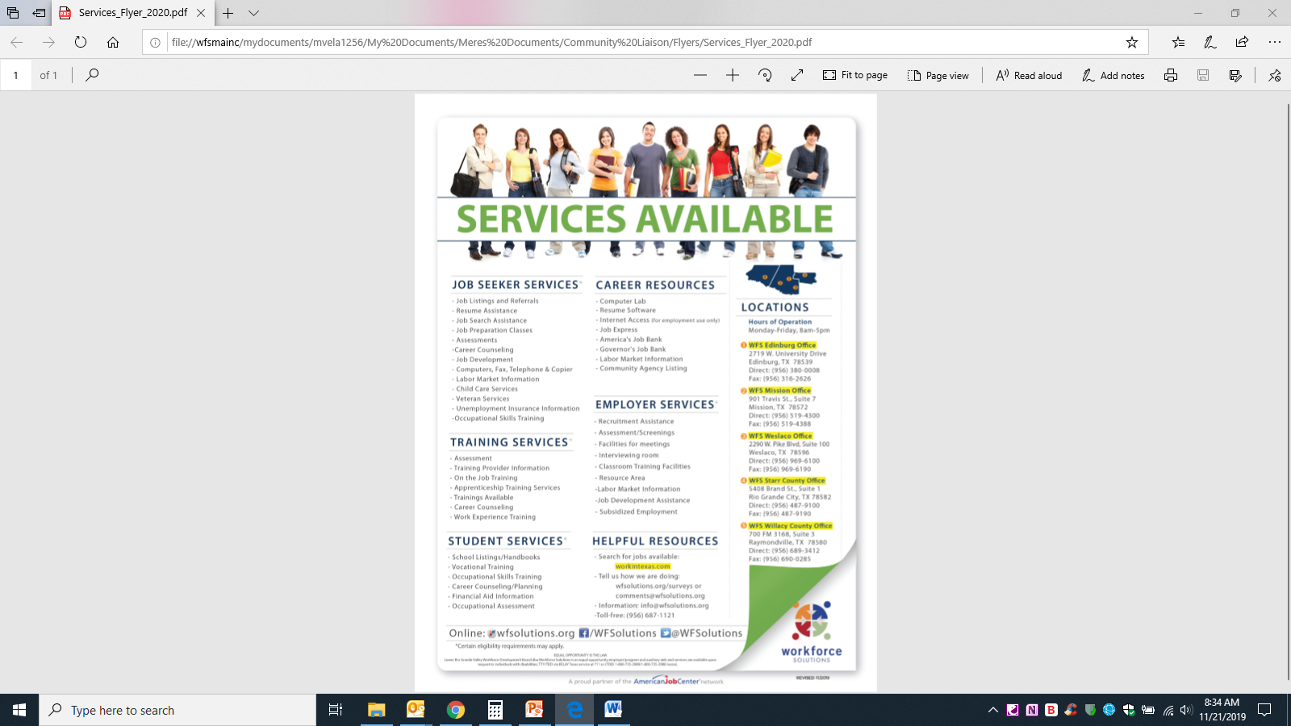
Services Available
Resource Room
Training Opportunities
Financial Aid
Career Counseling
Job Matching
Target Populations
Referrals to Community Partners
Fidelity Bonding
Support Services
Child Care Assistance
Assessments
Workshops

Slide 12
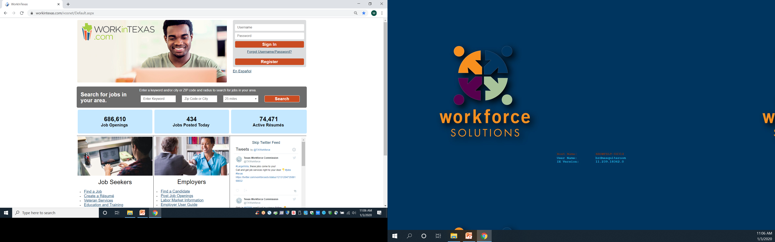
workintexas.com
WorkInTexas.com is provided at no cost, 24 hours a day, seven days a week, and seeks to match qualified job seekers with potential job opportunities, online and in real time, by comparing things like work experience, skills, abilities, education and other factors.

Slide 13
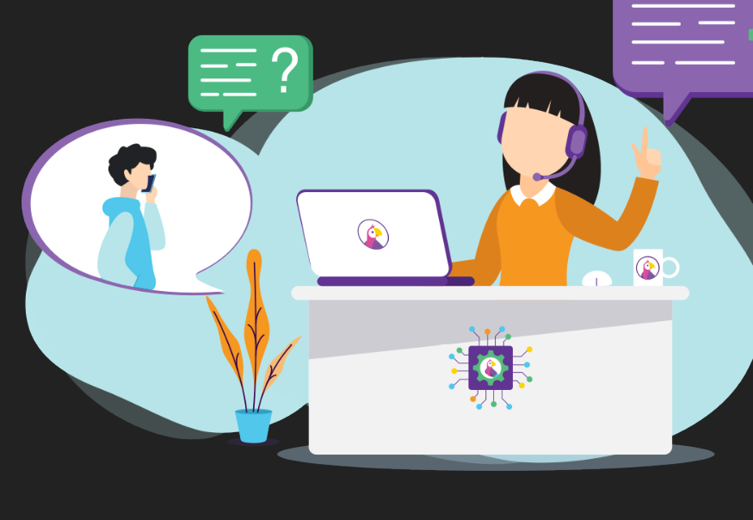
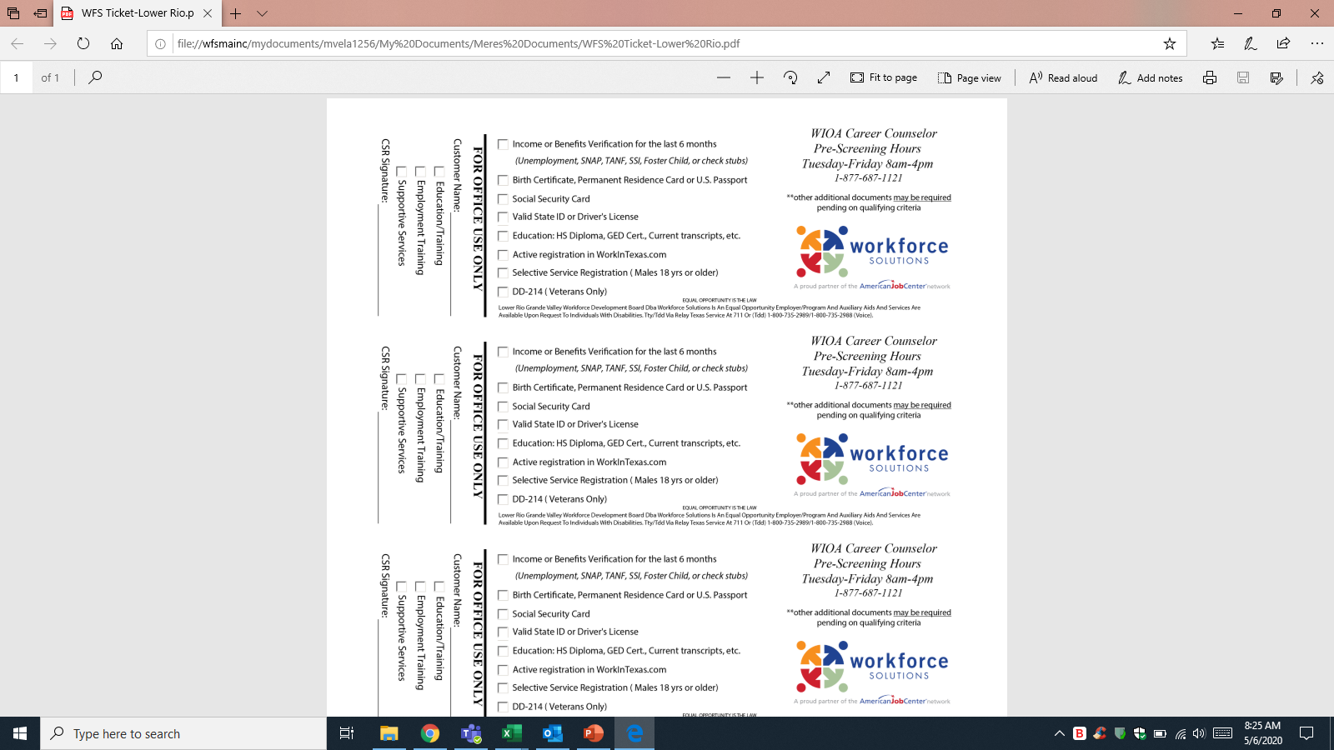
Employment
Though we are all being affected with our current situation our team is doing everything possible to bring you employment opportunities throughout the whole Rio Grande Valley using a similar session as today.

Slide 14


Employment
TIP: You can use Zoom for FREE! You don't need to pay for a plan or create an account to use Zoom.
💻📱 Download Zoom for your desktop at https://zoom.us/ or search "ZOOM Cloud Meetings" on your mobile phone or tablet app store to get ready for our virtual job fair.

Slide 15

Employment
We regularly share job openings, hiring events, and job fairs in the Rio Grande Valley. We also share services, opportunities, and resources that Workforce Solutions makes available to the community.
Please follow us on
Facebook: /RGVOP

Slide 16
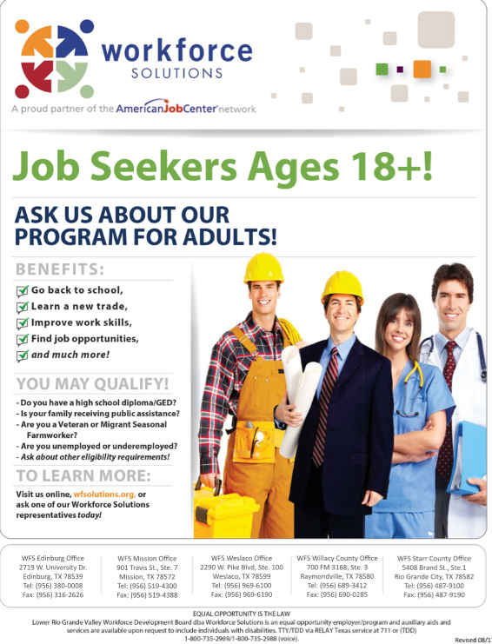
Workforce Innovation and
Opportunity Act (WIOA)
The trainings sponsored by WFS are based on local business/employer needs.
Currently, WFS sponsors approximately 100 trainings, including but not limited to:
  Associates in Nursing (LVN/RN)
  Pharmacy Technician
  Truck Driver
  Combination Welder
  Electrician

Slide 17
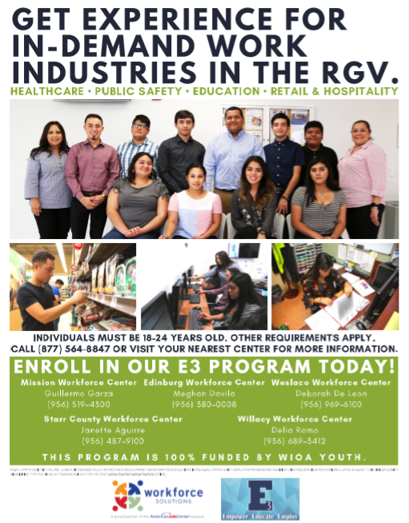
E3 Program
Our E3 Program –Empower Educate, and Employ!
This program is targeting our youth ages 18-24 who are interested in Healthcare, Public Safety, Education, Retail & Hospitality.
Job Readiness
Career Exploration
Work Experience
All while getting paid!

Slide 18
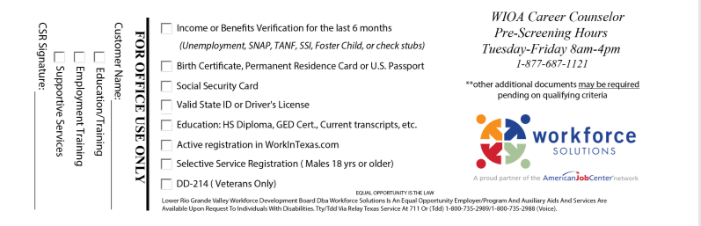
Eligibility for WIOA
General Orientations are held Tuesday through Friday at 9:00AM and 1:30PM at your nearest Workforce Center.
CALL NEAREST Workforce Center PRIOR TO ATTENDING

Slide 19
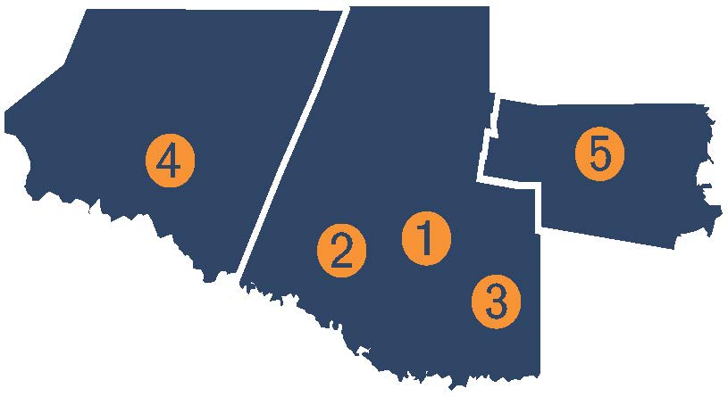
Workforce Solutions Offices
  WFS Edinburg Office
    2719 W. University Dr.
    (956) 380-0008
  WFS Mission Office
    901 Travis St., Ste.7
    (956) 519-4300
  WFS Weslaco Office
    2290 W. Pike Blvd #100
    (956) 969-6100
  WFS Starr County Office
  5408 Brand St., Ste. 1
  (956) 487-9100
  WFS Willacy County Office
  700 FM 3168, Ste. 3
    (956) 689-3412
    Toll Free: (877) 687-1121

Slide 20
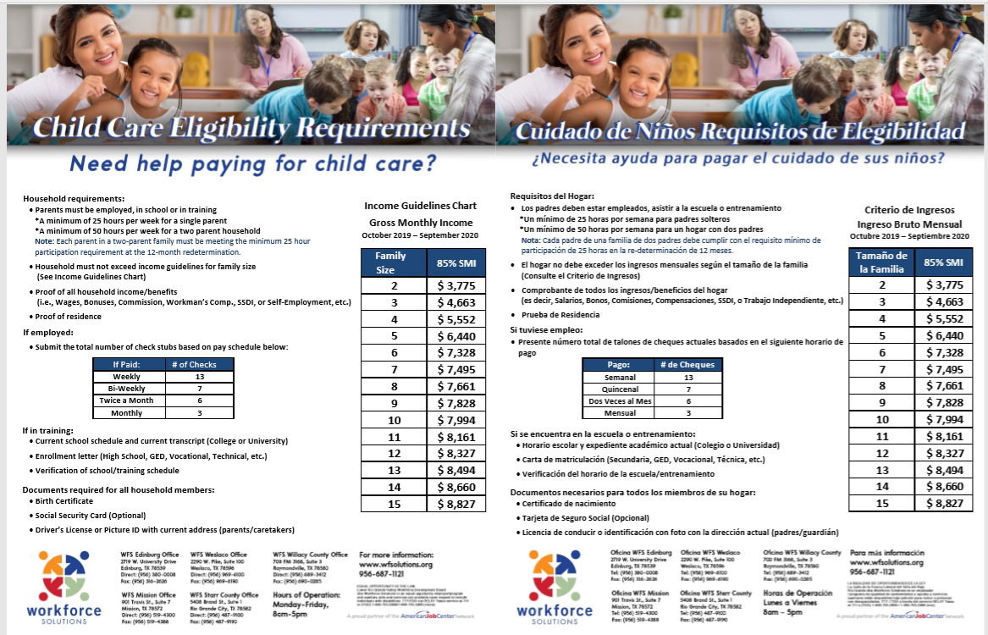
Child Care Services

Slide 21

Important Reminder!
If you secure employment, be sure to notify a
WFS staff member.

Slide 22
Equal Opportunity
EQUAL OPPORTUNITY IS THE LAW
Lower Rio Grande Valley Workforce Development Board
dba Workforce Solutions
is an equal opportunity employer/program
and auxiliary aids and services are available upon request
to individuals with disabilities.
TTY/TDD via RELAY Texas service at 711
or
(TDD) 1-800-735-2989/1-800-735-2988 (voice).

Slide 23
QUESTIONS?

Slide 24
Contact Information
Mere Vela
Community Liaison
Office: (956) 928-5000
Mobile: (956) 638-1024
E-mail: mere.vela@WFSolutions.org
Online: WFSolutions.org
Facebook: /WFSolutions/iJobsRGV
Twitter: @WFSolutions

Slide 25

Leigh Ann Godinez, CRC, LPC, CTCM
Lower Rio Grande Management Unit 6-3 VR Supervisor
Gabriela Martinez, CRC, LPC
Lower Rio Grande Management Unit 6-3 VR Supervisor

Slide 26


Vocational Rehabilitation
Transition Services – An Introduction

Slide 27
Vocational rehabilitation (VR) Services
Purpose: to help people with disabilities obtain and maintain employment that is consistent with the strengths, interests, abilities, and aptitudes
VR services are eligibility-based and tailored to the individual
They are not intended to be emergency services
They are not time-limited, but are not intended to be provided long-term
They are arranged and provided by a Vocational Rehabilitation Counselor (VRC), with consideration for individual choice

Slide 28
Eligibility criteria
The customer has a physical or mental impairment (first criterion);
The impairment constitutes or results in a substantial impediment to employment (second criterion);
The customer requires Vocational Rehabilitation (VR) services to prepare for, enter, engage in, or advance in competitive integrated employment consistent with the customer's strengths, resources, priorities, concerns, abilities, capabilities, interests, and informed choice (third criterion); and
The customer can achieve an employment outcome, unless pre-eligibility trial work experiences demonstrate by clear and convincing evidence that the customer cannot achieve an employment outcome because of the severity of the customer's disability (fourth criterion).

Slide 29
Transition services
Transition services are provided to help students move from high school to successful work and independent living. Through partnerships with the schools, VR provides these services to students while they are attending high school so they will be prepared when they exit. After a person leaves high school, Vocational Rehabilitation services continue to be available to them, if necessary.
Transition services are a subset of Vocational Rehabilitation Services for those individuals aged 14-22
In most cases, the services provided to transition students fall into one of these 5 Pre-Employment Transition Services (Pre-ETS) categories:
    1. Career Exploration 4. Job Readiness
    2. Work-Based Learning 5. Self-Advocacy
    3. Counseling on Post-Secondary Opportunities

Slide 30
Vocational Rehabilitation Counselors
TVRCs:
- Assigned to various schools and spend most of their time on school campuses.
VRCs:
- Counselors with general caseloads and high school liaison assignments.
  The majority of schools have a counselor assigned. If you are not sure who the assigned counselor is at your school, contact the Regional Transition Specialist for your area.

Slide 31
Workforce Innovation and opportunity act (WIOA)
Many students with disabilities are leaving secondary school without competitive integrated employment or being enrolled in postsecondary education, and there is a need to support such students as they transition from school to postsecondary life.
WIOA emphasizes transition and youth services throughout.

Slide 32
WIOA TiTLE IV
Title IV of the Workforce Innovation and Opportunity Act (WIOA) changes in the way transition services are provided through Vocational Rehabilitation.
VR programs are required to spend 15% of their federal funding allocation on Pre-Employment Transition Services (Pre-ETS) to eligible and potentially eligible students with disabilities.
Pre-ETS are intended to provide exposure to the concepts and experiences related to building skills for work and independent living and are, therefore, more effective when started early.

Slide 33
Potentially eligible
The Workforce Innovation and Opportunity Act (WIOA) introduced a new eligibility status, Potentially Eligible.
As a means to give access to Pre-ETS activities, some individuals will be able to participate as potentially eligible.
    Must meet the definition of student with a disability
    Not intended to circumvent the Vocational Rehabilitation (VR) process - when it is realized that other services are needed, an application for services must be completed
Services to this population are limited to Pre-ETS

Slide 34
How to get started…
Work with your assigned VR counselor to refer students for services. If you aren’t sure who the counselor is, call your nearest Texas Workforce Solutions-Vocational Rehabilitation (TWS-VRS) office or your area’s Regional Transition Specialist (contact info on the next slide). For a list of TWS-VRS offices, visit: www.texasworkforce.org/offices/vr-general-services.html
The counselor will schedule appointments at the school, in the Workforce Solutions office, or at other locations to complete the application for services.
The counselor will discuss the VR process with students and parents, which includes determining eligibility and, if eligible, assessment and planning for services.
Notes:
Explain each phase, including time frames for each
Please be sure to explain that services are designed to connect a person with a disability with work. That process, set of needs and set of solutions looks different for every one and other agencies/organizations and people have responsibilities in the process so we try to partner for the best use of Federal and State funds. We expect that transitioning students and their stakeholders participate, make decisions, work with us to overcome barriers and seek solutions.
If the consumer and the counselor can’t reach a decision together, advocacy services are available to help facilitate the process through Texas Disability Rights. Area Managers are also available to help work through issues when needed and there is a formal appeal process available as well. Details can be accessed on the DARS website or in brochures provided at every office .

Slide 35
Regional Transition Specialists
Region and contact person: Phone number:
Region 1- West Texas: Andrew Castillo 915-834-7701
Region II- Dallas/Fort Worth: Rosla Hocker 817-436-4127
Region III- Central Texas: Vacant 512-407-1320
Region IV- East Texas: LeAnn Bolwerk 903-266-2168
Region V- Houston: Kristen Davis 832-681-2643
Region VI- South Texas: Mayra Gutierrez 210-805-2208

Slide 36
State office transition team
Erin Wilder, Program Manager Kevin Markel
512-936-3707 817-759-3514
Erin.Wilder@twc.state.tx.us Kevin.Markel@twc.state.tx.us
Tammy Winkenwerder Zenaida Olivas
512-936-3708 915-834-7042
Tammy.Winkenwerder@twc.state.tx.us Zenaida.Olivas@twc.state.tx.us
Laura Villarreal Lauren Hargrove
512-936-3559 512-936-4303
Laura.Villarreal@twc.state.tx.us Lauren.Hargrove@twc.state.tx.us
Pre-ETS Mailbox VR.Pre-ETS@twc.state.tx.us

Slide 37
Texas Workforce Commission
Contact information
Texas Workforce Solutions-Vocational Rehabilitation Services
101 East 15th Street
Austin, Texas 78778-0001
800-628-5115
Equal Opportunity Employer/Program
Auxiliary aids and services are available upon request to individuals with disabilities.
Relay Texas: 800-735-2989 (TTY) and 711 (Voice)
The Texas Workforce Commission accepts calls made through any relay service provider.

Slide 38
VR Offices in The Region One ESC Area
Cameron County Management Unit Serves Cameron County
1812 W. Jefferson Avenue
Harlingen, TX 78550
Phone: 956-368-5200
VR Manager: Ralph Rangel
VR Supervisor: Lorissa Luna
Lorissa.Luna@twc.state.tx.us
Golden Crescent/Coastal Bend
Management Unit
Serves Brooks & Jim Hogg County
1814 Brahma Blvd
Kingsville, TX 78363
Phone: 361-592-1006
VR Manager: Joey Crow
VR Counselor: Norma Pena
Norma.Pena@twc.state.tx.us
Phone: 361-412-8958
Lower Rio Grande Management Unit
Serves Hidalgo, Starr and Willacy County
801 W. Nolana, Suites 115 & 120
McAllen, TX 78504
Phone: 956-661-5480
VR Manager: Antonio Ocana
VR Supervisor: Leigh Ann Godinez
LeighAnn.Godinez@twc.state.tx.us
VR Supervisor: Gabriela Martinez
Gabriela.Martinez@twc.state.tx.us
South Texas Middle Rio Management Unit
Serves Webb & Zapata County
4611 Foster Avenue
Laredo, TX 78041
Phone: 956-523-8050
VR Manager: Janette Ramos
VR Supervisor: Joe Lee Herrera
Joe.Herrera@twc.state.tx.us

Slide 39
Federal funding information
For purposes of the Vocational Rehabilitation program, the Federal Vocational Rehabilitation grant pays 78.7 percent of the total costs of the program. In Federal fiscal year 2020, the Vocational Rehabilitation agency anticipates receiving $287,666,847 in Federal Vocational Rehabilitation funds. Funds appropriated by the State pay 21.3 percent of the total costs ($77,856,466) under the Vocational Rehabilitation program.
For purposes of the Supported Employment program, Federal funds paid 90 percent of the total costs. In Federal fiscal year 2020, the Vocational Rehabilitation agency received $1,446,266 in Federal Supported Employment funds. State appropriated funds paid 10 percent ($80,348) of the total costs under the Supported Employment program.
For purposes of the Independent Living Services for Older Individuals who are Blind program, Federal funds paid 90 percent of the total costs incurred under the program. In Federal fiscal year 2020, the agency received $2,159,283 in Federal grant funds for this program. Funds appropriated by the State paid 10 percent ($239,920) of the total costs incurred under the Independent Living Services for Older Individuals who are Blind program.

Slide 40
QUESTIONS?

Slide 41

Perla Y. Leo, MS, C.R.C.
Coordinator of Student Disability Services

Slide 42


Counseling and Student Disability Services
Perla Leo, M.S., CRC

Slide 43
Self Advocacy
High School | College
Student is identified by the school and is supported by parents and teachers. | Student MUST self-identify to the office of disability services.
Primary responsibility for arranging accommodations belongs to the school. | Primary responsibilities for self-advocacy and arranging accommodations belongs to the student.
Teachers approach you if they believe you need assistance. | Professors are usually open and helpful but most expect YOU to initiate contact if you need assistance.

Slide 44

Student Disability
Services

Slide 45
What does our OFFICE DO?
We coordinate appropriate and reasonable accommodations.
Our goal is for each student to receive an equal opportunity to learn, participate in campus life, and successfully complete a program of study.

Slide 46
the responsibility of our office
To meet with the student, review documentation
Determine appropriate and reasonable classroom accommodations
To complete an intake of the student requesting accommodations.
To provide a “Memo of Accommodations” to the student to present to the instructor.

Slide 47
Who qualifies FOR Student disability services?
An individual who:
Has a physical or mental impairment which substantially limits a major life activity.
Has a record or history of such an impairment.
Is regarded as having such an impairment.

Slide 48
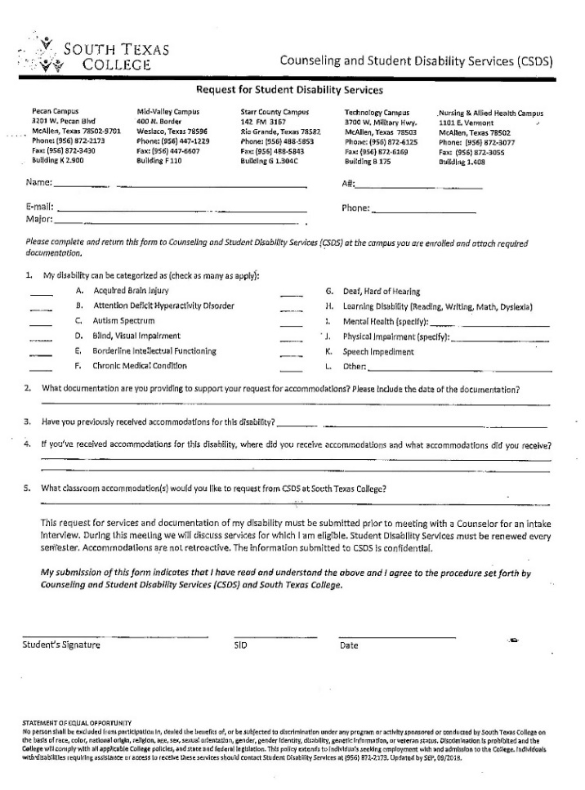

How does a student request our services?
1. Apply and be accepted to South Texas College. Students with disabilities must go through the standard admission process. Register for course(s).
2. Complete the Request for Student Disability Services form and submit it to the counselor at the campus student is attending.
3. Provide documentation of a disability. Document upload now available at our Student Portal.
4. Student participating in an intake interview for classroom accommodations

Slide 49
What are the responsibilities of the student with a disability?
A student must self-identify to the SDS office that he/she has a disability and needs accommodations.
The student must bring current documentation (three years or less) of his/her disability to the SDS office.
The student must request accommodations with the SDS office every semester.

Slide 50
What are the responsibilities of the instructors?
Instructor and student will discuss the accommodations memo in private. Preferably during office hours.
The instructor will sign the accommodations memo and return it to the student or our office.
If instructor disagrees or has any questions, he or she should call the counselor that provided the accommodations memo.

Slide 51
Can the instructor and the student change or set up any Accommodations as they see fit?
No. The instructor should not provide a student with any accommodation without verification from the SDS office that a disability has been documented in his/her file.

Slide 52
Adaptive Technology & Software
Counseling & Student Disability Services purchases adaptive technology and software as needed to meet the needs of students with disabilities.
Software and adaptive technology is purchased and/or selected based on the student’s reasonable requests/needs.

Slide 53
Supplementary Aids and Services
Adaptive equipment—such as magnifiers, calculators, color screens, furniture
Assistive technology—such as a word processor, special software, or a communication system
Tutoring, note takers, readers, scribes, sign language interpreters
Adapted materials—such as electronic books, large print, etc.
Testing accommodations—such as extended time, alternate test site, oral administration, supervised breaks

Slide 54
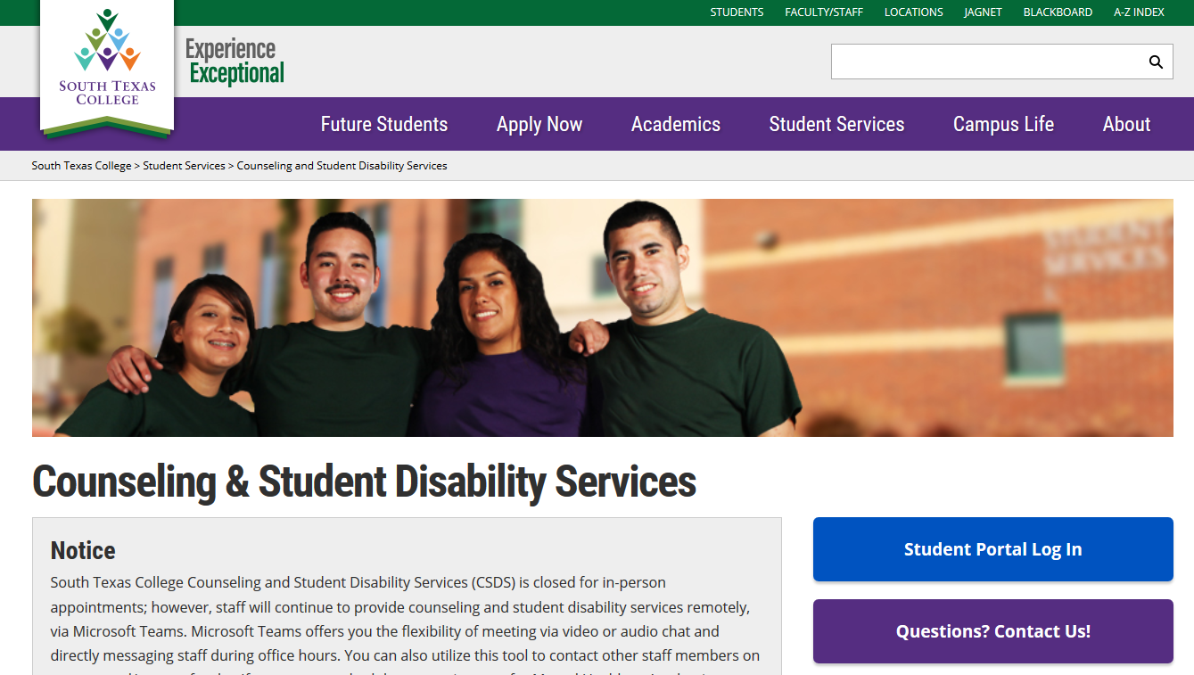
OUR Website https://studentservices.southtexascollege.edu/counseling/index.html

Slide 55

HOW TO REACH US
disability@southtexascollege.edu
Perla Leo, M.S., CRC
Coordinator of Student Disability Services
956-872-2165
ppena_4867@southtexascollege.edu
Pecan Campus-Building K 2.721

Slide 56

Questions, Comments, Concerns…

Slide 57

Nancy Aguirre,
Counseling Specialist

Slide 58

Nancy Aguirre, Counseling Specialist

Slide 59

At UTRGV
SAS serves approximately 450 students during each Fall and Spring semester.
Considerations:
  Not all students with a disability register with SAS.
  Each person with (or without) a disability is unique.
  All students learn differently.

Slide 60

The Legal Foundation
Americans with Disabilities Act (ADA, ADAAA) & Rehabilitation Act (Section 504)
  Prohibit discrimination against students and employees with disabilities.
Colleges are not required to fundamentally alter the nature of their academic programs.
Disability rights are civil rights.

Slide 61
When Do These Laws Apply?
Academic settings (classrooms, labs, clinicals)
University-sponsored events and
non-academic settings (athletic events, residence halls, dining halls)
Field placements (clerkships, internships)
In the “virtual world” (videos, websites, online learning)
https://www.youtube.com/watch?v=AwDvgFrbY5w
UC Davis School of Medicine
Captions in operating room

Slide 62
Types of Disabilities
Learning Disability (Math, Reading (Dyslexia), Written Expression)
Speech/Language
Vision impairments (including blindness)
Deafness/Hearing impairments
Orthopedic/Mobility
Mental Health (PTSD, Depression, Bipolar, Anxiety, etc.)
Autism Spectrum Disorder
Traumatic Brain Injury
Other health impairments (Diabetes, Seizure Disorder, ADHD, etc.)

Slide 63
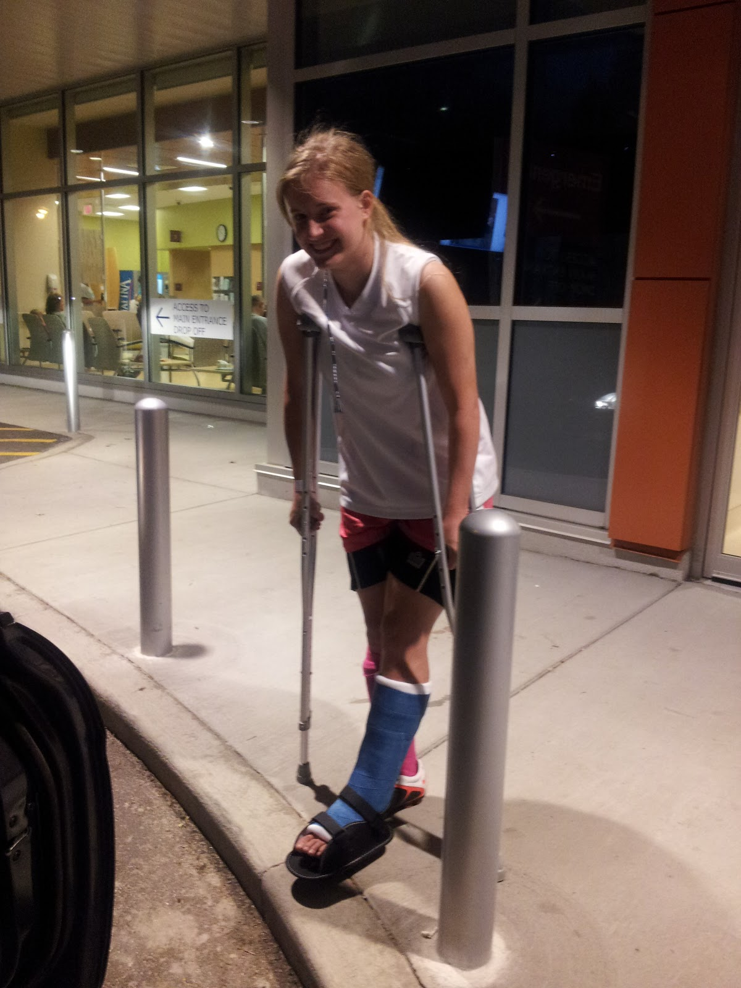
Temporary Disabilities
Temporary disabilities include, but are not limited to:
broken limbs
burns
post‐surgery recovery
and similar conditions that temporarily impair or influence a student’s ability to fully participate in academic activities.

Slide 64

How Disability Affects Students
Including but not limited to:
Taking longer to process information
Relating to others
Ability to focus
Attendance
Ability to express thoughts in writing
Ability to complete physical class activities
Notes:
Change title

Slide 65
Title IX: Pregnancy, Pregnancy-related, and Parenting
UTRGV is committed to creating and maintaining a community where all individuals enjoy freedom from discrimination, including discrimination on the basis of sex, as mandated by Title IX of the Education Amendments of 1972.
Sex discrimination, which can include discrimination based on pregnancy, marital status, or parental status, is prohibited and illegal in admissions, educational programs and activities, hiring, leave policies, employment policies, and health insurance coverage.
UTRGV is committed to the protection and equal treatment of students who may be pregnant, experiencing a pregnancy-related condition, and or are new parents.

Slide 66
Requesting Pregnancy, Pregnancy-related, and Parenting Accommodations
https://www.utrgv.edu/accessibility
https://www.utrgv.edu/accessibility/pregnancy-parenting/index.htm
Documentation requirements (including expected due date)

Slide 67
Eligibility for Services
Students must register with SAS.
Submit current documentation from a qualified professional (Additional documentation may be requested).
Participate in an interactive interview with SAS counselor.
Accommodations are determined on a case-by-case basis.

Slide 68
Documentation Required for Eligibility
Documentation should include an evaluation by a qualified professional that makes evident the disability and the current impact of the disability (i.e. “functional limitations”) as it relates to the accommodation(s) request.

Slide 69
Examples of Accommodations
Priority registration
Priority seating
Distraction-reduced testing environment
Extended test time (time determined by SAS office)
Sign language and captioning
Alternate format of course materials
Volunteer note taker
SAS Accommodation Glossary: utrgv.edu/sasglossary

Slide 70
Accommodation Letters
A student’s accommodation letter must be kept confidential by instructors.
No information will appear on transcripts related to a student’s disability.
A student’s disability will not be included in an accommodation letter.

Slide 71

Accommodations:
Provide students equal access to the same information / educational experiences their peers.
Provide the same opportunities to demonstrate mastery.

Slide 72
Accommodations:
Should not fundamentally alter the essential objectives of an academic program, curriculum or course, or lower the standards
Do not ensure academic success or otherwise provide an advantage.

Slide 73

Confidentiality
All student information, including documentation that is submitted to SAS, is kept confidential and secure according to the Family Educational Rights and Privacy Act (FERPA) guidelines.

Slide 74
Registering for Services
Students may register with SAS any time during the semester or academic year either by visiting the office or online: utrgv.edu/mysas
Students can apply once they have their UTRGV credentials.
However, accommodations are not retroactive.
An interactive intake appointment is required for individualized accommodations to be considered.
Students should register with SAS each semester if they wish to continue receiving accommodations.

Slide 75
QUESTIONS?

Slide 76
Student Accessibility Services
Edinburg
University Center 108
(956) 665-7005
Brownsville
BMSLC 1.107
(956) 882-7374
ability@utrgv.edu
Website: utrgv.edu/accessibility
SAS Accommodation Glossary: utrgv.edu/sasglossary

Slide 77

Genesis Lezama,
Peer and Transition Services Coach

Slide 78

Presentation by: Genesis Lezama
Peer and Transition Services Coach

Slide 79
Mission statement & Motto
VAIL is organized to serve people with disabilities in the greater Rio Grande Valley and South Texas. VAIL is committed to enabling persons with disabilities to gain effective control and direction of their lives in the home, in the workplace and in the community.
VAIL’s goal is to stimulate and promote a growing sense of personal dignity and empowerment through individualized programs designed to provide the tools necessary for maximum independence and community participation.
“Promoting independence and personal dignity through self-directed services for persons with disabilities.”

Slide 80

Consumer-controlled
VAIL IS A 501 c(3) nonprofit, non-residential, consumer-controlled, community based cross disability organization providing independent living services to individuals with disabilities since 1988.
The term center for independent Living means a:
consumer-controlled
community-based
cross disability
nonresidential
private nonprofit agency

Slide 81
Independent Living Center
Information and referral – VAIL specialists are knowledgeable about resources in the community and can refer consumers to the programs that can be most helpful to them.
Independent living skills – VAIL specialists provide skills training in areas such as money management, time management, use of public transportation, proper use of medications, Use of assistive devices, personal and home safety, prescription assistance, personal advocacy and much more.
Individual and systems advocacy – VAIL specialists help consumers stand up for their rights as individuals to live independently, and work for changes in society that would better support independent living for people with disabilities.
Peer counseling – Counselors who have disabilities may share similar experiences and may better understand what barriers others with disabilities encounter. VAIL peer counselors are prepared to assist you to make your own choices and reach your goals to live independently in your community.

Slide 82

Who Qualifies?
Person with a disability
Any age group
Caretaker, guardian, and local representative

Slide 83
Programs and services that VAIL has to offer:
  Mobility Management Services
  Independent Living CORE services
  Deaf Services & CRP job placement
  Community Living Assistance and Support Services (C.L.A.S.S)
  Technology Resources
  MS Support Group
  Independent Living Purchasing program
  Project Housing Education and Advocate Rural Texas (H.E.A.R.T)
  Peer & Advocacy Leadership (P.A.L.S)
  IL Virtual Program

Slide 84
Contacts at VAIL
Executive director: Susan Nelson snelson@vailrgv.org
Program Director: Lidia Fonseca lfonseca@vailrgv.org
Peer and Transition Services coach: Genesis Lezama glezama@vailrgv.org

Slide 85


Mobility Management Services
Our services provide mobility services for seniors and people with disabilities.
We meet with the consumer to plan trips using available transit systems, and assist them to obtain transportation vouchers if needed from United Way.
We are knowledgeable about all transit systems, and work to improve mobility in small urban and rural areas.
We Serve Cameron, Willacy, Hidalgo and Starr Counties.

Slide 86
Independent Living Program
Help consumers have more control over their lives with access to:
Information & Referral Services
Advocacy Services
Specialized Telecommunications Assistance Program
Medication Assistance
Educational/Vocational
Transitional Support Services
Veteran-Supportive Services

Slide 87

Texas Specializes Telecommunication Assistance Program (STAP)
STAP allows for Texas residents with disabilities to obtain access to devices for telecommunication as voucher program. STAP provides financial assistance with use of vouchers to pay for these devices.
These devices range from voice amplifier, large button, braille, two texting, bluetooth compatible, pre-programed dialer, speaker phone and artificial larynx.
Another part of the program provides speech generated devices such as eye control, communication board and specialized movement control telecommunication devices.
Consumer is allowed to replace once every 5 years and voucher per household is permitted.

Slide 88
Deaf Services
VAIL provides many services for people who are Deaf or Hard-of Hearing. These services include:
Information & Referral
Communication Access (Interpreter Service and STAP)
Peer Counseling
Advocacy Services - EEOC, Fair Housing, ADA and others
Advocacy-Education (In-State Tuition Waiver)
CRP Job Placement
Transition Services
Recreational Social events.

Slide 89
CRP PROGRAM
Placing people with disabilities in competitive employment
Job Placement
Job Coaching
Job Coach for the Deaf
Vocational Adjustment Training
Vocational Adjustment Training for the Deaf
Personal Social Adjustment Training
Personal Social Adjustment Training for the Deaf
Supported Employment Services

Slide 90
Community Living Assistance Support Services (C.L.A.S.S.)
Who Qualifies?
  People who have a developmental disability before age 22
  Disability may be due to a variety of conditions including:
    Cerebral Palsy
    Muscular Dystrophy
    Spina Bifida
    Epilepsy
    Head Injury
  Participants must be limited in at least 3 of the following life activities:
  Learning
  Mobility
  Self-Care
  Language
  Self-Direction
  Independent Living
  *Participants must be receiving SSI OR related Medicaid Coverage.

Slide 91

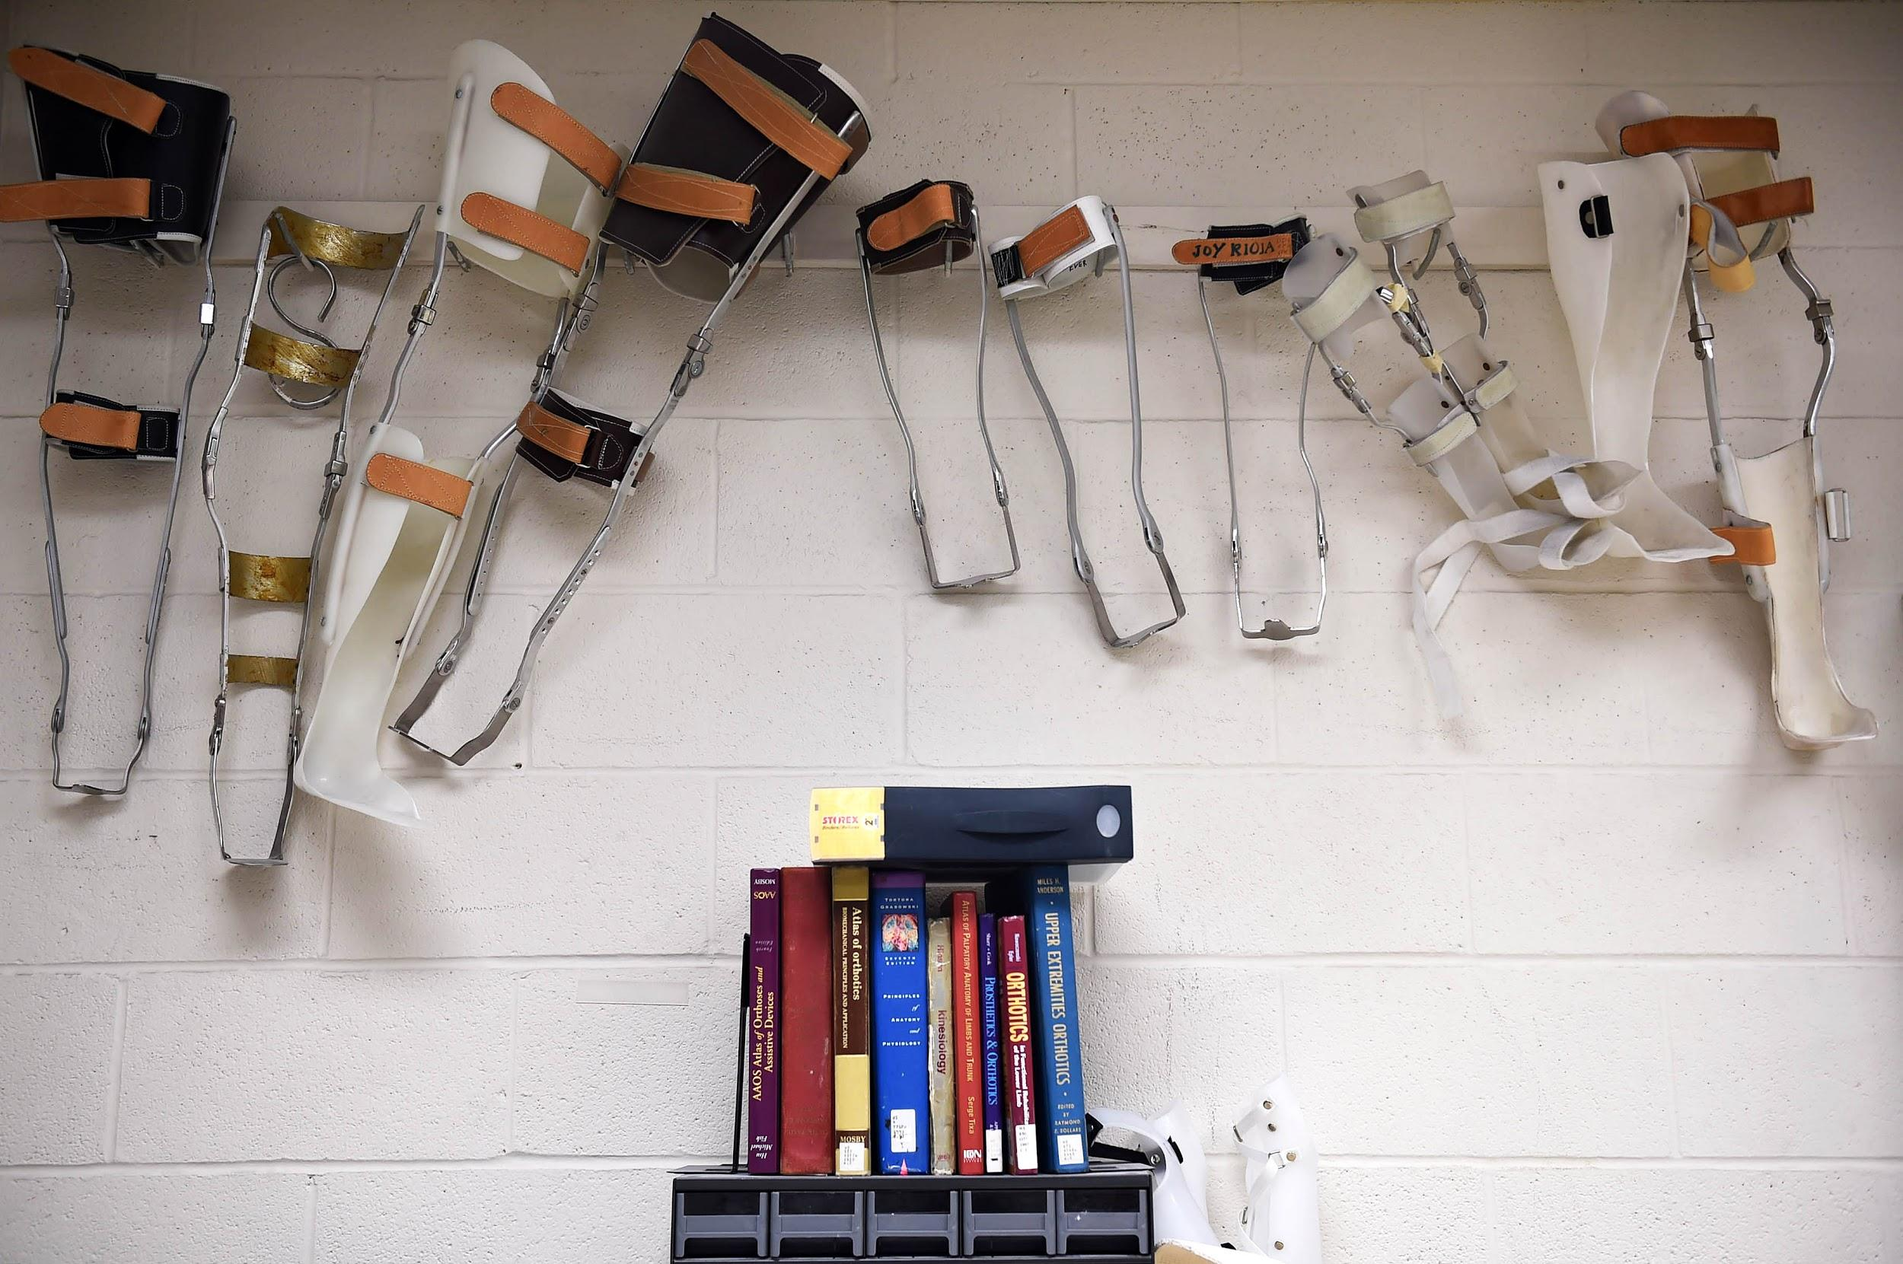
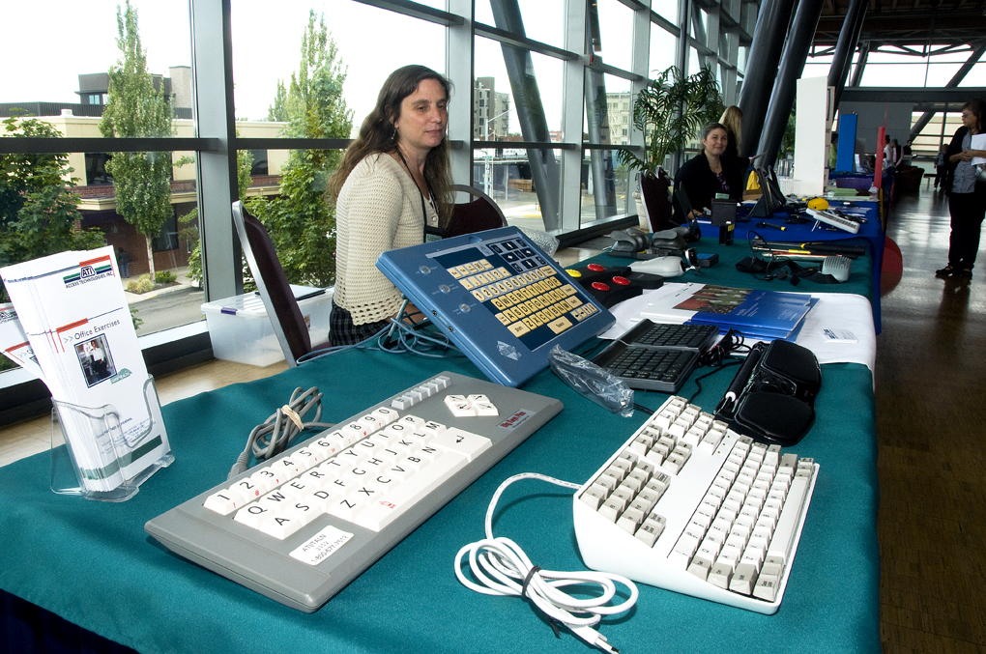
AT Demo Lab
The University of Texas Technology Access Project has provided VAIL with
  Modified laptops that have software for individuals who have a visual, speech or mobility impairment.
  Hands On Demonstrations are provided on using the assistive and adaptive technology.

Slide 92
MS Support Group
Meet others living with multiple sclerosis (MS)
Join us in discussions
listen to guest speakers and socialize.
Share your tips on maintaining an active, healthy and fulfilling life with MS.

Slide 93
Independent Living Purchasing program
If you qualify, VAIL’s new ILS Outsourcing program can help pay for items that can facilitate your ability to live independently. To qualify, you must be present in Texas and have a significant disability.
Examples of some of these items include:
Mobility Aids (Wheelchairs, Walkers, etc. | Assistive technology (reading pen, etc,)
Ramps | Grab bars
Hearing Aids | Counseling
Diabetes Education | Vision Services
Interpreting | Physical, Occupation & Speech Therapies
Recliner lifts | Minor home modifications
Vehicle modifications | And much more!

Slide 94
Project HEART
Assistance transition individual from institution back into the community with Coast Bend Center of Independent Living
Housing Education and Advocacy for Rural Texans (HEART)
Effective July 1, 2018, Texas SILC accepted an award from TCDD and started the HEART project. HEART, in collaboration with Centers for Independent Living VAIL and DIA, will increase advocacy for people with disabilities and increase access to integrated, affordable, and accessible housing within the community of their choice. Specifically, Project HEART will achieve this goal by sponsoring the following activities:
Creating systems change by increasing the number of people with developmental disabilities on housing boards, commissions, advisory committees, and other planning bodies;
Providing leadership and advocacy training that increase the skills of people with and without developmental disabilities; and
Developing housing coalitions created to increase the number of housing opportunities for people with developmental disabilities.

Slide 95
IL Virtual Program
Gabi Bridges and Mario Martinez
mbridges@vailrgv.org
mmartinez@vailrgv.org

Slide 96


PAL Program - Peer Advocacy and Leadership
■ Project PAL is an initiative by Texas State Independent Living Centers and its partners to facilitate the training of at least 25 Texans with Developmental Disabilities to serve as Peer Support Specialist for 250 individuals with Developmental Disabilities.
In the context of this training program, the peer counselor will be someone who acknowledges having a disability and does counseling with another person with a disability.
Requirements: Having an IDD, being a current resident of the state of Texas, being an adult 18 y/o +, being a registered voter or willing to register to vote.

Slide 97
Transition services
Pilot program at Donna ISD.
Provided a 6 week program based on the curriculum provided ‘Teens and Transition’
T’NT is a curriculum designed to prepare young adults (ages 16-22) with high incidence disabilities to become employed, independent members of their communities. The curriculum actively engages students in a variety of topics including: post-secondary education, job training, soft skill development, mock interviews, housing, insurance, financial literacy, and accessing community resources.
Topics covered are Communication & Self-Advocacy, Career Exploration, Searching for Jobs Applying for Jobs & Other Opportunities, Preparing a Resume, Preparing for Interviews, Mock Interviews, Being a Good Employee, Banking, Budgets & Credit, Job Training & Certifications, Post-Secondary Education, Independent Living Simulation, Housing, Insurance, Transportation, Community Resources & Participation.

Slide 98


Office Locations
3012 North McColl Road
McAllen, TX 78501
956.668.8245 (VAIL) - voice
1.866.400.8245 (VAIL) toll free
956.631.7914 - fax
McAllen
1419 Corpus Christi
Laredo, Texas 78040
956.523.1411 - voice
956.523.1417 - fax
Laredo
** Funded by U.S. Dept. of Health and Human Services – Admin for Community Living (ACL), Health and Human Services Commission (HHSC), Texas Council on Development Disabilities. **

Slide 99
Questions?
WE COMMUNICATE IN:
ENGLISH, SPANISH, AMERICAN SIGN LANGUAGE, MEXICAN SIGN LANGUAGE, GESTURES AND PICTOGRAMS.

Slide 100

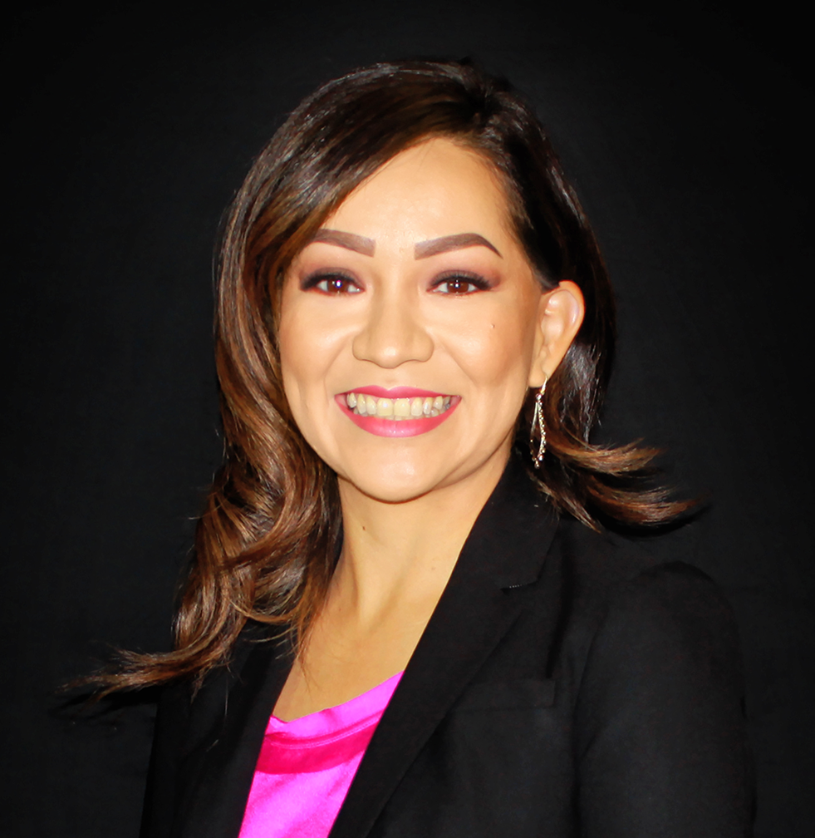

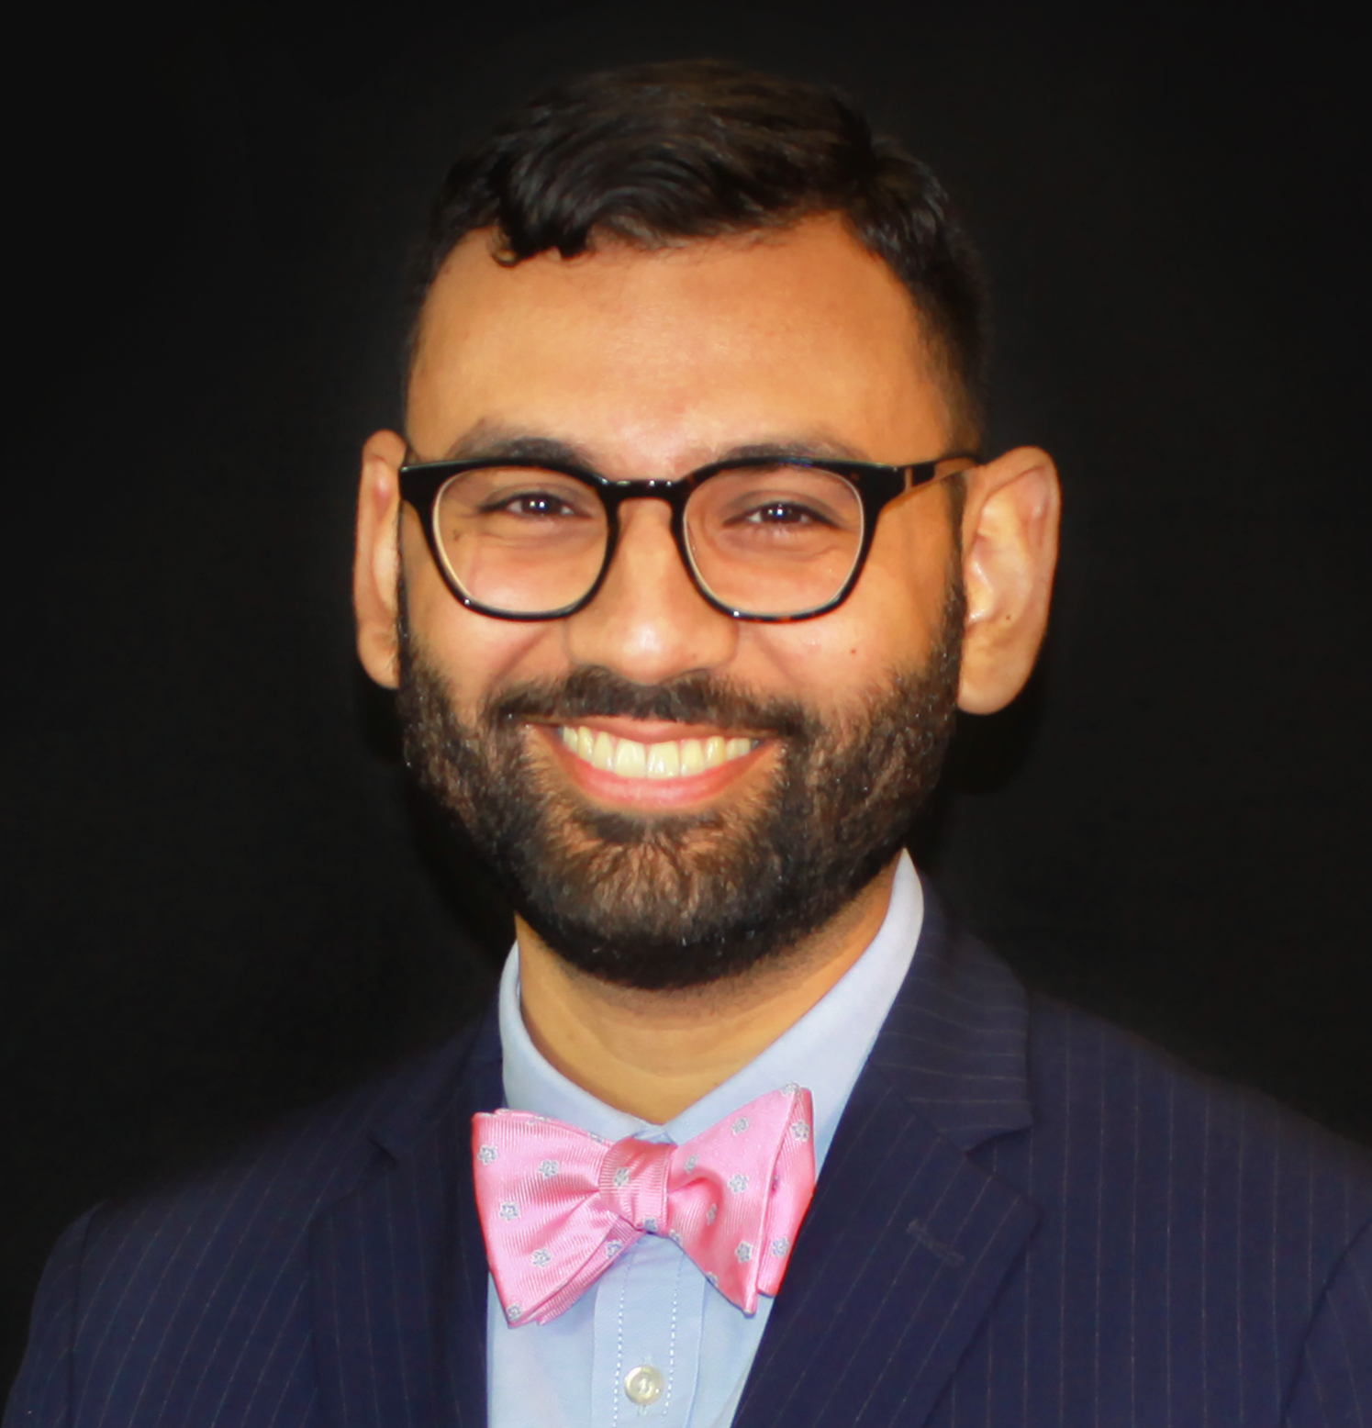
Contact Information
Jeannette Escalera
jeannette@wfsolutions.org
Phone (956) 683-3751
Mobile (956) 638-0966
Ricky Rendon
ricky@wfsolutions.org
Phone (956) 683-3762
Mobile (956) 638-0495

Slide 101
Thank you!

